Slide 1
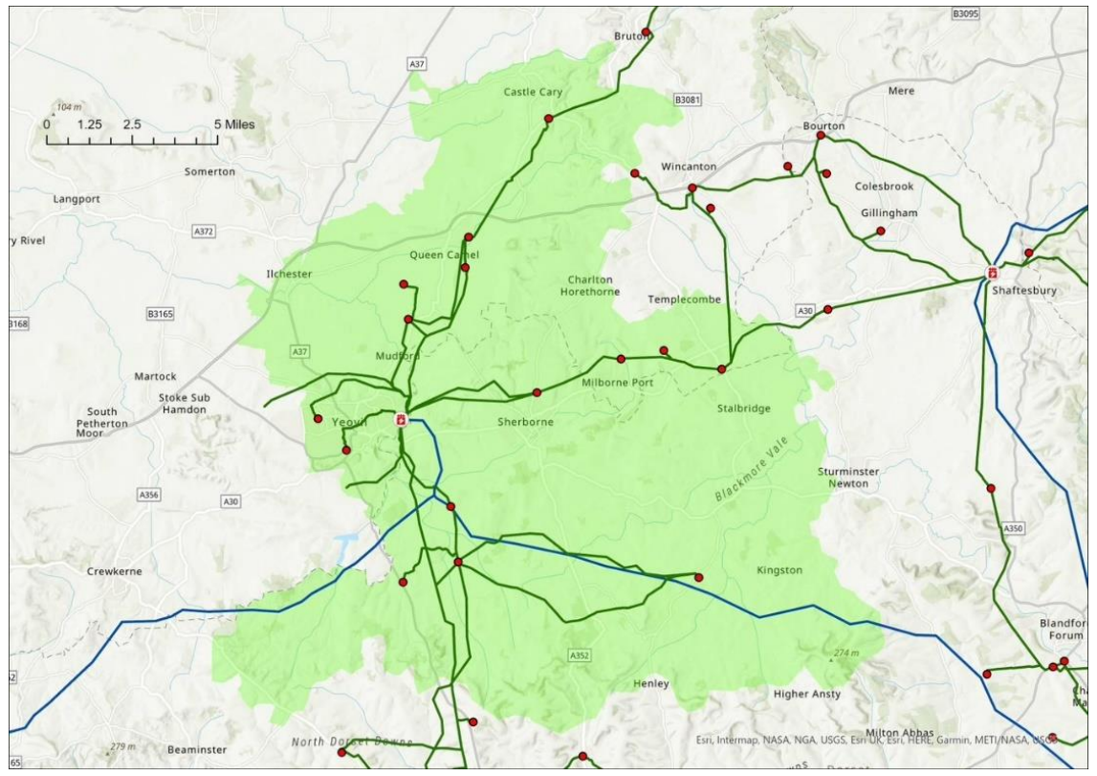
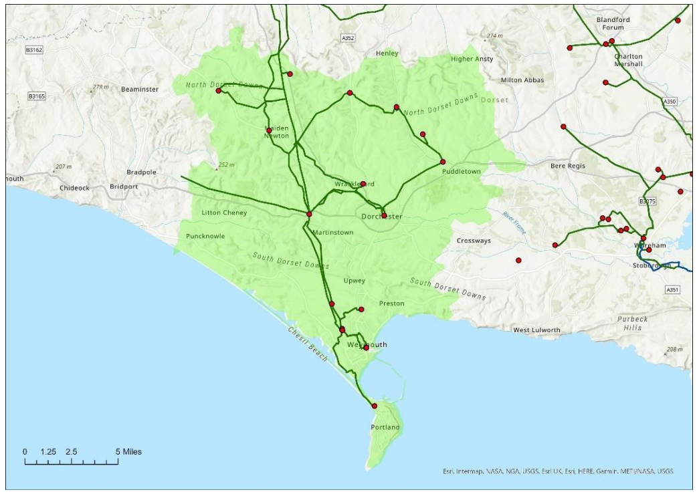
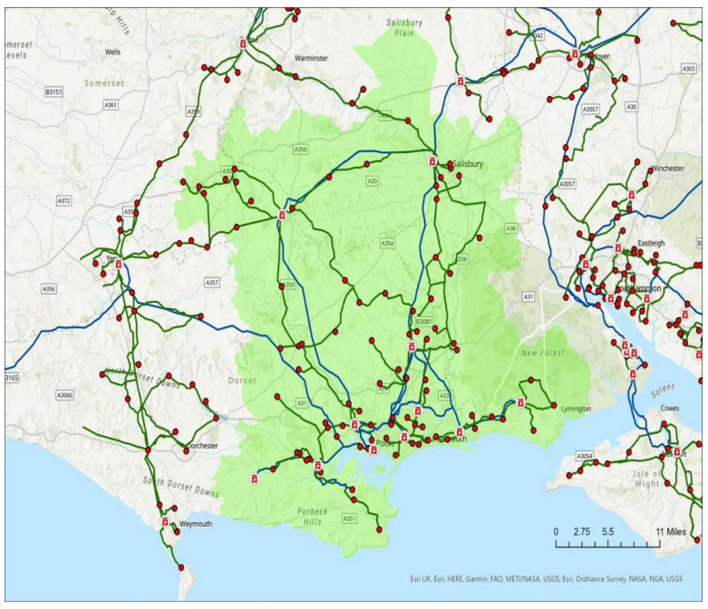



Grid Capacity Review Place & Resources Scrutiny Committee Task & Finish Group Session 2: Council Officers | 6 November 2023

Slide 2

What is the objective of these sessions?
To grow understanding and awareness of the impacts of grid constraints, how to adapt to them, and plans for future grid reform and investment.
To gather better insight and evidence into user needs and challenges.
To strengthen relationships with network operators and our capacity for influence on future strategic planning and investment.
1
2
3
Session 1:
Introductory
background briefing
Session 2:
Info gathering with DC officers
Session 3:
Info gathering with local stakeholders
Session 4:
Info gathering with local stakeholders
Session 5:
Review, recommendations & next steps
Today:
Impacts upon the council’s ability to deliver (e.g. DC estate retrofitting, our community retrofitting programmes, EV infrastructure, planning and development, and economic growth).
2
Notes:
Thanks for joining us again today.
The main point of today’s session is to consider the impacts upon the council’s own programmes and ambitions.
We’re grateful to be joined by officers from across the council, who will be able to offer insight into how grid constraints impact upon their own work.

Slide 3
Agenda today
1.
2.
3.
The Grid and Network Development Plans
Forecasting example: Electric Vehicles
Q&A with officers
3
Notes:
The agenda is similar to before: we’ll start off with a couple of presentations before then getting into the Q&A with officers.
Our first presentation will look a little more into the nature of the grid locally and the network operator’s plans to address constraints.
Lots of that planning involves forecasting what future generation and demand might be, and whilst there’s too much to cover there in this session our second presentation from Chris and Owen will look at the specific example of electric vehicles.

Slide 4
The Grid and
Network Development Plans
Notes:
So kicking off, we’re going to quickly look into a bit more detail on the grid.
There’s a lot of detail again that we can only skim over quickly, but we’ll provide notes again where you can look in the detail you’re most interested in.
Here we just want to give you a flavour of what is available.

Slide 5





















What is the grid?
Policy framework
Regulator
Transmission Network Operator
Generators
Transmission network
(High voltage)
275/400kV
Energy System Operator (balancing)
11kV
33/66kV
132kV
Distribution network
(Low voltage)
Distribution Network Operators (DNOs)
Distribution Substations (LV)
Primary Substations (PSS)
Bulk Supply Points (BSP)
Grid Supply Points (GSP)
Feeder lines
230/400V
*Formerly WPD
Energy suppliers
End consumers
5
Notes:
Just a reminder, last time we noted these different components of the grid.
Let’s look in a little bit more detail at what this bit highlighted looks like locally.

Slide 6

How is demand forecast? Business planning
Dorset’s key grid infrastructure
Grid Supply Points
Axminster
Chickrell
Mannington
Bulk Supply Points (13)
Bournemouth
Chickerell
Christchurch
Lytchett
Mannington
Poole
Redhill
Salisbury
Shaftesbury
Wareham
Winfrith heath
Yeovil
Woodcote (NGED)
Primary Substations (53)
Christchurch | Hamworthy | Bourton | West Hendford
Blandford | East Howe | Gillingham | Yeovil
Corfe Mullen | Redhill | Shaftesbury | Cerne Abbas
Creekmoor | Homington | Shroton | Charminster
Winterbourne Kingston | Gussage St Michael | West Stour | Chickerell
Ferndown | Minchington | Wincanton | Dorchester Town
Fordingbridge | Tarrant Rushton | Parkstone South | Maiden Newton
Hinton Martell | Henstridge | Bovington | Redlands
Mannington | Pulham | Bushey | Weymouth
Mill Lane, Ringwood | Sherborne | Swanage | Portland
Rockbourne | Yetminster | Wareham Town | Beaminster (NGED)
Verwood | Piddletrenthide | Chilton Cantello | Bridport (NGED)
Wimborne | Puddletown | Milborne Port | Penn Cross (NGED)
Wimborne St Giles
6
Notes:
As a reminder, there are 3 Grid Supply Points (Axminster in the west, Chickrell near Weymouth, and Mannington out East), and this are owned by National Grid Transmission.
SSEN is the Distribution Network Operator for most of Dorset, with a small section to the west controlled by National Grid Electricity Distribution (‘NGED’).
The assets of most relevant to Dorset include these 13 Bulk Supply Points and 53 Primary Substations.
Those few at the bottom of the lists belong to NGED as indicated – all the rest are SSEN’s.
In addition to the lines and cables connecting them, this is much of what we’re talking about when we refer to the distribution network in Dorset – and much of whose capacity we’re interested in when we talk of constraints.

Slide 7

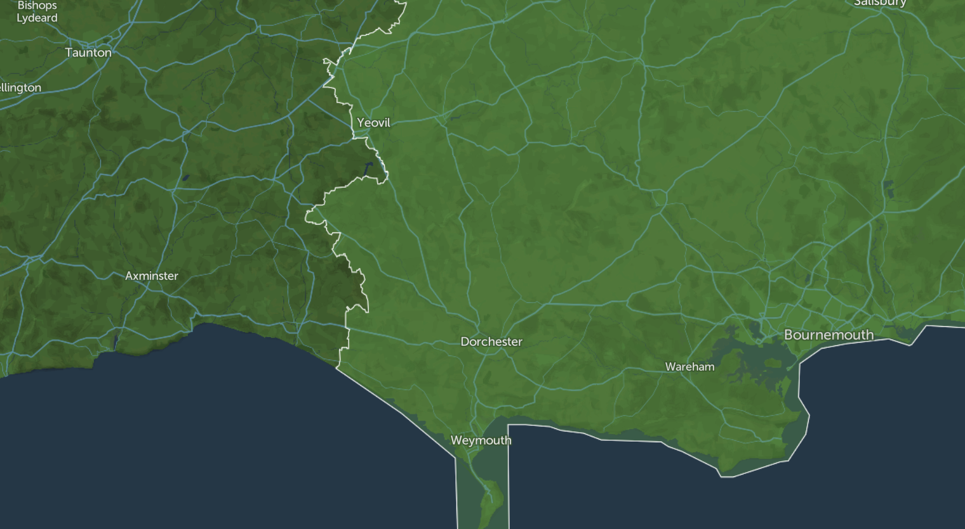


Salisbury BSP
Shaftesbury BSP
Yeovil BSP
Mannington GSP
(Supplies all other BSPs - ~408,000 customers)
Axminster GSP
(supplies Yeovil BSP - 47,400 customers)
Woodcote BSP (NGED)
Redhill BSP
Lytchett BSP
Poole BSP
Wareham BSP
Winfrith Heath BSP
Chickerell BSP
Chickerell GSP
(supplies Chickerell BSP – 62,000 customers)
7
Notes:
To show this spatially, this is the location of the 3 Grid Supply Points alongside the Bulk Supply Points.
It’s too dense to try and show the Primary Substations on here – but if you visit the links here you can explore this map, and look at the details of all these bits of infrastructure.
We’ll email you that after this session.

Slide 8
How is demand forecast? Business planning
Dorset’s key grid infrastructure
Axminster GSP
Supplies Yeovil BSP >47,000 customer
Chickerell GSP
Supplies Chickerell BSP >62,000 customers
Mannington GSP
Supplies all other BSPs ~408,000 customers
8
Notes:
But – appreciating this is too hard to see the detail on here – this is the detail with the substations.
Key point here is that there essentially these three areas being served by the three respective grid points.
The big one is of course Mannington, which covers most of the substations and customers.

Slide 9
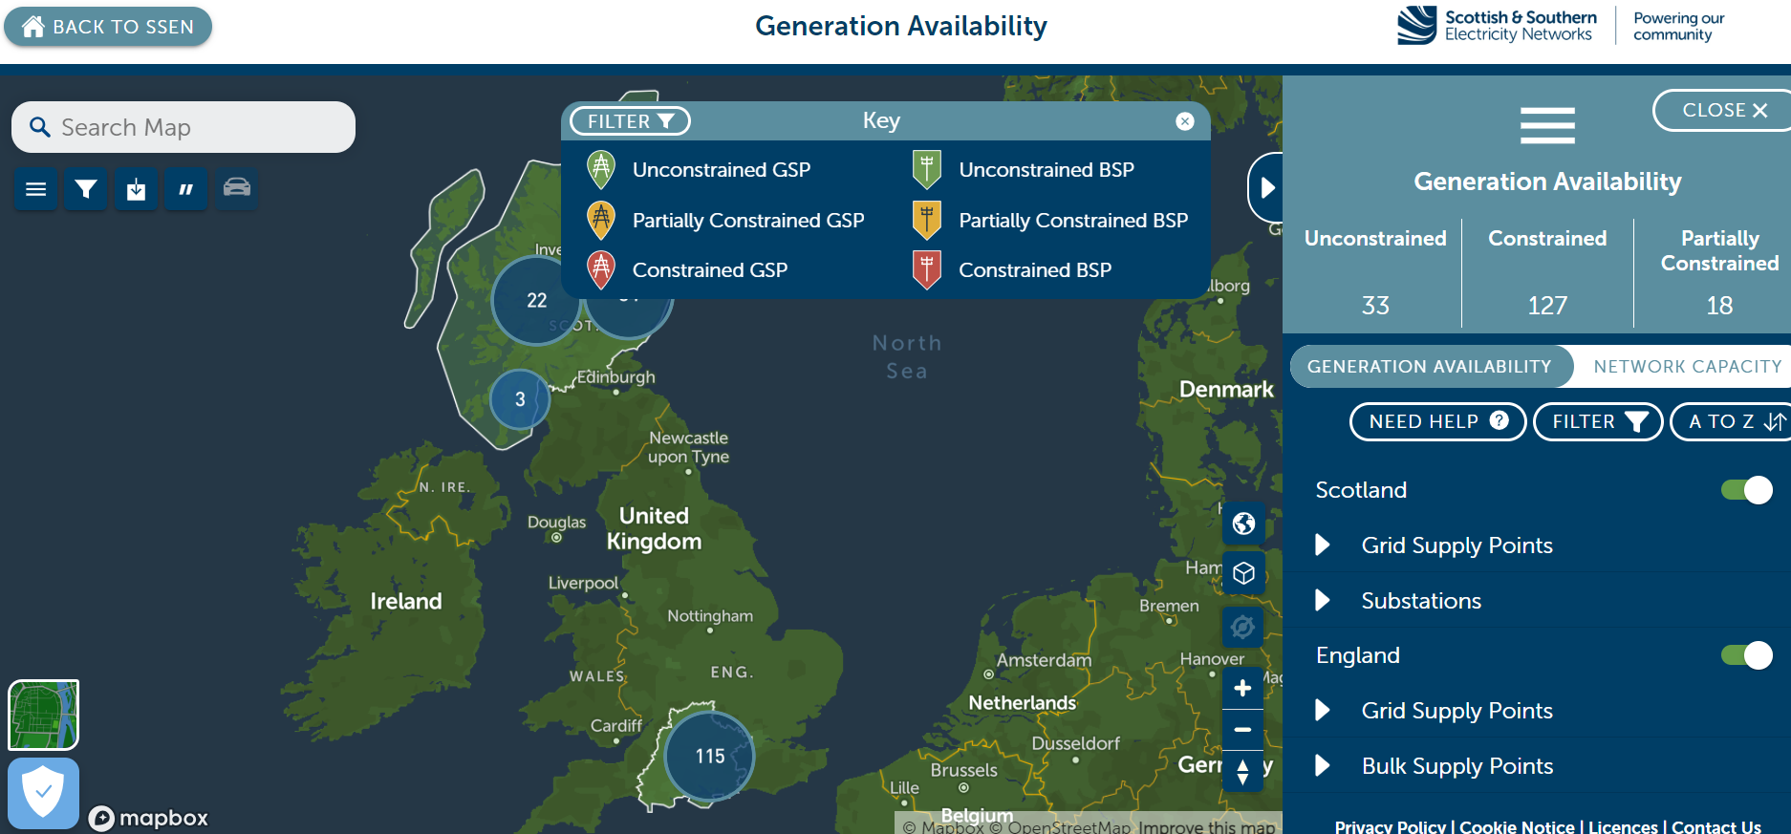
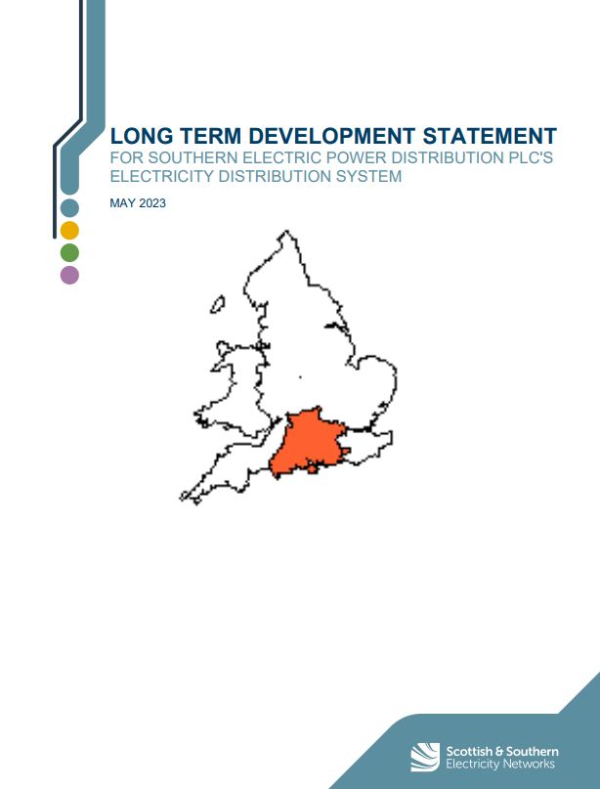
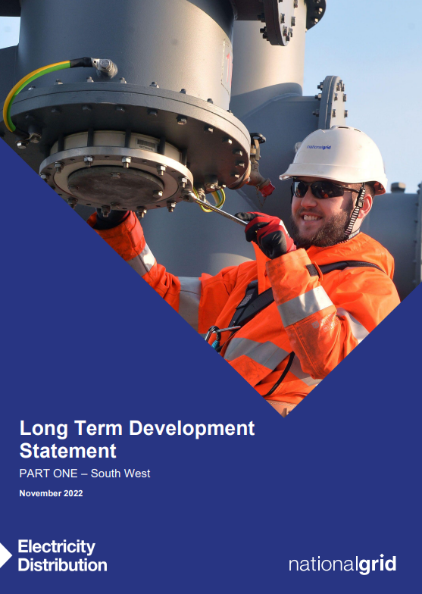
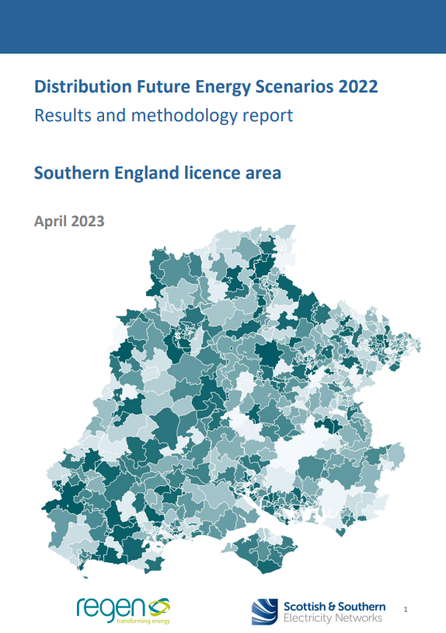
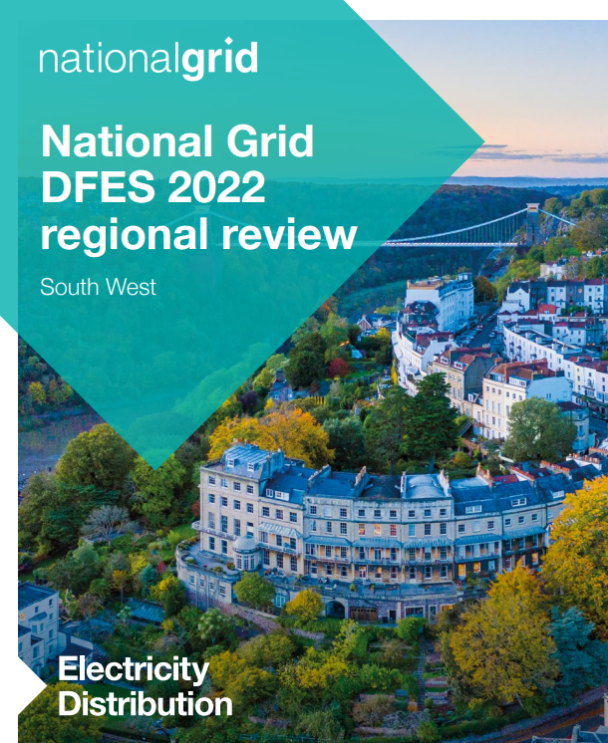

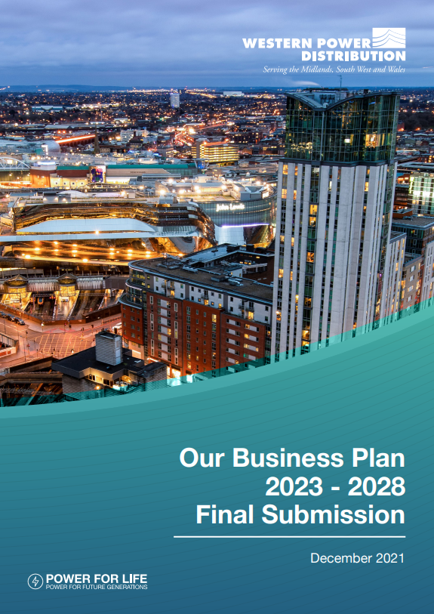

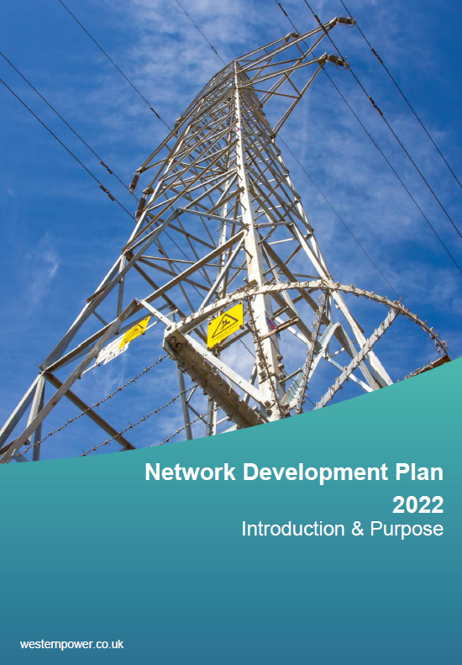
How is demand forecast? Business planning
Information & network planning documents
Heat
Maps
Updated regularly.
Show current constraints and capacity.
Show where reinforcements would most likely be triggered.
Long-term Development Statements
Annual statements (November).
Rolling 5yr view.
Show expected constraints for the next 5 years.
Distribution Future Energy Scenarios
Annual analysis
Scenario-based, projections.
Forecast constraints to 2050.
RIIO-ED Business Plans
Produced for each 5yr RIIO-ED period (now 2023-28).
Approved by Ofgem.
Informed by the DFES.
Network Development Plans
10yr plan.
Show intent…
…but can be modified by new DFES analysis and are subject to Business Plan approval.
9
Notes:
As we said last time, the network operators submit business plans for each 5-yr investment period to Ofgem.
But there are a suite of documents or sources of information that inform on constraints and intent to address them. The key ones to mention are:
Online heat maps which show where there’s currently headroom capacity, or where it’s limited or non-existent. These can help inform developers where connections are more or less likely to trigger reinforcements.
Long-Term Development Statements are annual statements which give a rolling 0-5yr view, showing where is expected to reach capacity in the next 5 years. They’re published each November and updated each May.
Distribution Future Energy Scenarios we mentioned last time. They are annual, scenario-based, long-term projections to 2050 using four scenarios.
RIIO-ED Business Plans we also mentioned last time. They are the investment proposals that have to be approved by Ofgem for each 5-year price control period (currently 2023-28).
And finally, Network Development Plans incorporate all of those, but give a longer-term 10yr plan to address constraints. But they only show intent: they’re subject to the Ofgem’s agreement of the underlying Business Plans, and can be modified if future forecasting suggests they need to be.
As such, given Shane’s concern noted in the last meeting about the shortness of the set 5-year Business Plan cycles, it is worth emphasising two things:
First, the forecasting in the forecasting projects to 2050.
And second, Network Development Plans indicate investment 10yrs ahead.
All of these are useful, but the Network Development Plans are worth looking at a little further.

Slide 10
How is demand forecast? Business planning
Network Development Plans
The Network Development Plan (NDP) (specifically, the ‘Network Scenario Headroom Report’ it contains) overviews forecast headroom capacity (or the lack of it) for Bulk Supply Points and Primary Substations to 2050.
It forecasts where there is capacity, where more is needed, and where flexibility services might be needed.
It considers all four of the DFES scenarios. The ‘Consumer Transformation’ scenario is considered most likely.
The faster we decarbonise, the faster constraints might bite – i.e. they’re a limiting factor on the pace of decarbonisation.
We show here the earliest date constraints could bite, which is not necessarily the most likely date.
Note two key things: Red doesn’t mean you can’t connect without reinforcement – other options (like flexibility) may be available. There are also upstream transmission constraints at our Grid Supply Points until 2036.
10
Notes:
The Network Development Plan (specifically, the ‘Network Scenario Headroom Report’ it contains) overviews forecast headroom capacity (or the lack of it) for Bulk Supply Points and Primary Substations to 2050.
This data is used by them to identify long-term opportunities to invest to alleviate constraints – so it’s a helpful basis to understand their thinking.
The future energy scenario analysis underpins the analysis, so it considers a wide range of demand sources (including things like EVs and heat pumps) and supply sources (including renewables, fossil fuels and battery storage). It is, of course, only as accurate as those forecasts.
These forecasts are done for all of the four future energy scenarios we mentioned before. Of course, the faster we decarbonise the quicker constraints are likely to bite – so note that the ‘worst case scenario’ for constraints appearing is often the ‘best-case scenario’ for getting to net zero.
Generally the ‘Consumer Transformation’ scenario is considered the most likely, but here we’re going to show you the earliest point at which constraints could appear – which is normally that scenario where we decarbonise fastest.
Next we’re going to show you the detail for the SSEN assets specifically, and their plans for investment.
On interpreting the next three slides, note two things:
First, red does not mean connections aren’t possible without reinforcement, as other options like flexibility may be available.
And second, there are also upstream transmission constraints at our Grid Supply Points which impair some connections, and which aren’t due to be resolved until 2036. These are noted in the report but aren’t reflected in the headroom values it projects. As such, it explicitly acknowledges that other factors will limit headroom, and that these will be identified during connection assessments.

Slide 11
BSP - DEMAND | Winter |  |  |  |  |  |  |  |  |  |  |  |  |  |  | Summer |  |  |  |  |  |  |  |  |  |  |  |  |  |  | Spring/Autumn
 | 2024 | 2025 | 2026 | 2027 | 2028 | 2029 | 2030 | 2031 | 2032 | 2033 | 2035 | 2040 | 2045 | 2050 |  | 2024 | 2025 | 2026 | 2027 | 2028 | 2029 | 2030 | 2031 | 2032 | 2033 | 2035 | 2040 | 2045 | 2050 |  | 2024 | 2025 | 2026 | 2027 | 2028 | 2029 | 2030 | 2031 | 2032 | 2033 | 2035 | 2040 | 2045 | 2050
BOURNEMOUTH
CHICKERELL
CHRISTCHURCH
LYTCHETT
MANNINGTON
POOLE
REDHILL
SALISBURY
SHAFTESBURY
WAREHAM
YEOVIL
BSP - GENERATION | Winter |  |  |  |  |  |  |  |  |  |  |  |  |  |  | Summer |  |  |  |  |  |  |  |  |  |  |  |  |  |  | Spring/Autumn
 | 2024 | 2025 | 2026 | 2027 | 2028 | 2029 | 2030 | 2031 | 2032 | 2033 | 2035 | 2040 | 2045 | 2050 |  | 2024 | 2025 | 2026 | 2027 | 2028 | 2029 | 2030 | 2031 | 2032 | 2033 | 2035 | 2040 | 2045 | 2050 |  | 2024 | 2025 | 2026 | 2027 | 2028 | 2029 | 2030 | 2031 | 2032 | 2033 | 2035 | 2040 | 2045 | 2050
BOURNEMOUTH
CHICKERELL
CHRISTCHURCH
LYTCHETT
MANNINGTON
POOLE
REDHILL
SALISBURY
SHAFTESBURY
WAREHAM
YEOVIL
Notes:
This here shows the earliest forecast dates for constraints for our Bulk Supply Points for each seasonal period to 2050, according to the Network Development Plan. Recall, these are the substation one level down from the 3 Grid Supply Points.
There are different constraints faced by demand connections which use electricity from generation connections which supply electricity.
The top ones show demand constraints, the bottom ones show generation constraints – and as you can see they are quite distinct.
There are specific values for the capacity in each of these cells, and we’ve stripped these out so this looks less intimidating – but we’ll share the detail with you after the session.

Slide 12
PSS – DEMAND | Winter |  |  |  |  |  |  |  |  |  |  |  |  |  |  | Summer |  |  |  |  |  |  |  |  |  |  |  |  |  |  | Spring/Autumn
 | 2024 | 2025 | 2026 | 2027 | 2028 | 2029 | 2030 | 2031 | 2032 | 2033 | 2035 | 2040 | 2045 | 2050 |  | 2024 | 2025 | 2026 | 2027 | 2028 | 2029 | 2030 | 2031 | 2032 | 2033 | 2035 | 2040 | 2045 | 2050 |  | 2024 | 2025 | 2026 | 2027 | 2028 | 2029 | 2030 | 2031 | 2032 | 2033 | 2035 | 2040 | 2045 | 2050
BLANDFORD
BOURTON
BOVINGTON
BUSHEY
CERNE ABBAS
CHARMINSTER
CHICKERELL
CHILTON CANTELLO
CHRISTCHURCH
CORFE MULLEN
CREEKMOOR
DORCHESTER TOWN
EAST HOWE
FERNDOWN
FORDINGBRIDGE
GILLINGHAM
GUSSAGE ST MICHAEL
HAMWORTHY
HENSTRIDGE
HINTON MARTELL
HOMINGTON
MAIDEN NEWTON
MANNINGTON
MILBORNE PORT
Mill Lane, Ringwood
MINCHINGTON
PARKSTONE SOUTH
PIDDLETRENTHIDE
PORTLAND
PUDDLETOWN
PULHAM
REDHILL
REDLANDS
ROCKBOURNE
SHAFTESBURY
SHERBORNE
SHROTON
SWANAGE
TARRANT RUSHTON
VERWOOD
WAREHAM TOWN
WEST HENDFORD
WEST STOUR
WEYMOUTH
WIMBORNE
WIMBORNE ST GILES
WINCANTON
WINTERBOURNE KINGSTON
YEOVIL
YETMINSTER
Notes:
Moving on to Primary Substations, this shows the picture for their demand constraints.
Again, as you can see, there’s a lot of variation across the primary substations.

Slide 13
PSS – DEMAND | Winter |  |  |  |  |  |  |  |  |  |  |  |  |  |  | Summer |  |  |  |  |  |  |  |  |  |  |  |  |  |  | Spring/Autumn
 | 2024 | 2025 | 2026 | 2027 | 2028 | 2029 | 2030 | 2031 | 2032 | 2033 | 2035 | 2040 | 2045 | 2050 |  | 2024 | 2025 | 2026 | 2027 | 2028 | 2029 | 2030 | 2031 | 2032 | 2033 | 2035 | 2040 | 2045 | 2050 |  | 2024 | 2025 | 2026 | 2027 | 2028 | 2029 | 2030 | 2031 | 2032 | 2033 | 2035 | 2040 | 2045 | 2050
BLANDFORD
BOURTON
BOVINGTON
BUSHEY
CERNE ABBAS
CHARMINSTER
CHICKERELL
CHILTON CANTELLO
CHRISTCHURCH
CORFE MULLEN
CREEKMOOR
DORCHESTER TOWN
EAST HOWE
FERNDOWN
FORDINGBRIDGE
GILLINGHAM
GUSSAGE ST MICHAEL
HAMWORTHY
HENSTRIDGE
HINTON MARTELL
HOMINGTON
MAIDEN NEWTON
MANNINGTON
MILBORNE PORT
Mill Lane, Ringwood
MINCHINGTON
PARKSTONE SOUTH
PIDDLETRENTHIDE
PORTLAND
PUDDLETOWN
PULHAM
REDHILL
REDLANDS
ROCKBOURNE
SHAFTESBURY
SHERBORNE
SHROTON
SWANAGE
TARRANT RUSHTON
VERWOOD
WAREHAM TOWN
WEST HENDFORD
WEST STOUR
WEYMOUTH
WIMBORNE
WIMBORNE ST GILES
WINCANTON
WINTERBOURNE KINGSTON
YEOVIL
YETMINSTER
Notes:
And then finally this is the forecast for primary substation demand constraints.
As you can see the picture here is a bit more rosey.

Slide 14
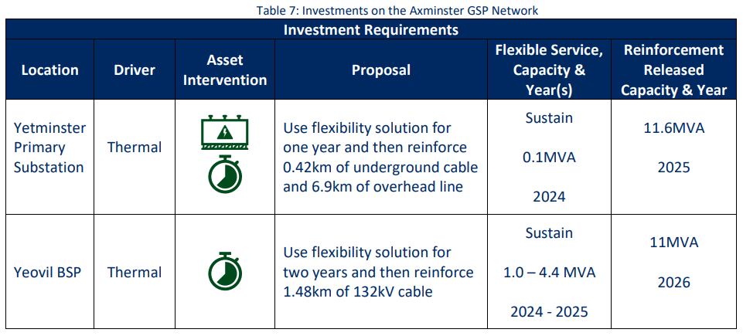
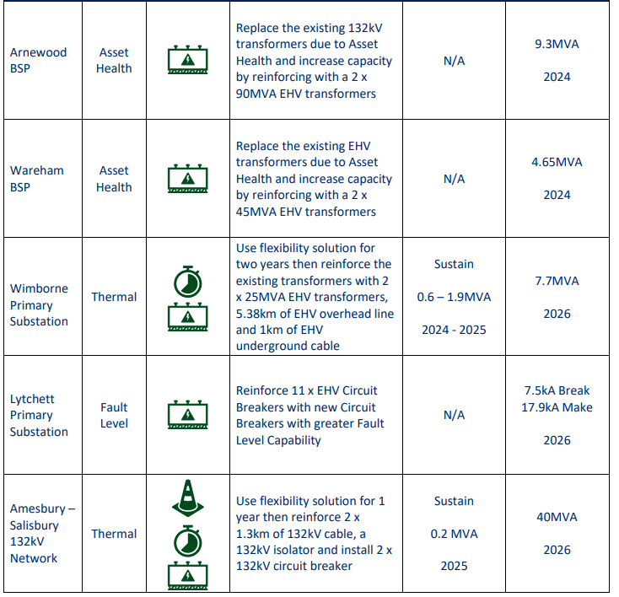
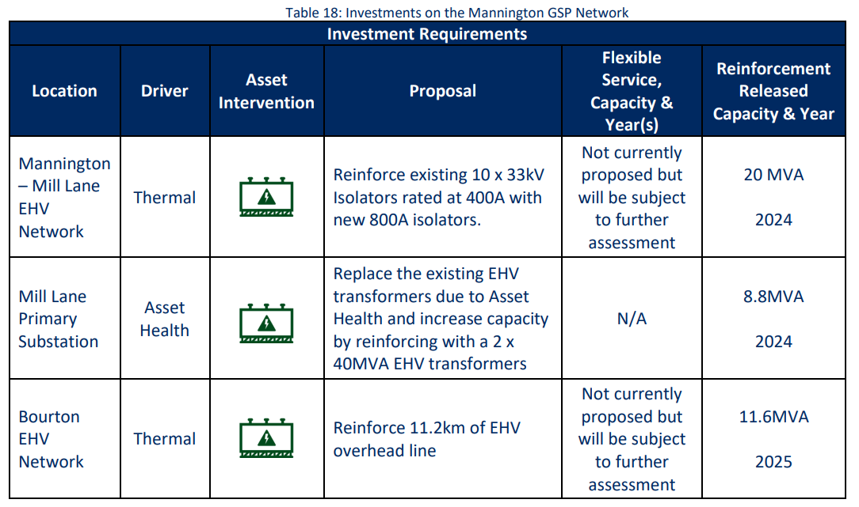
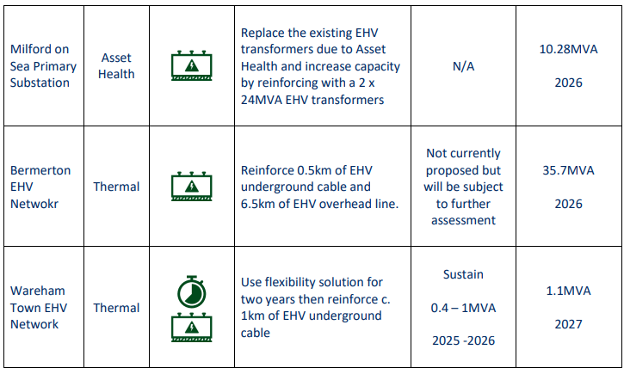
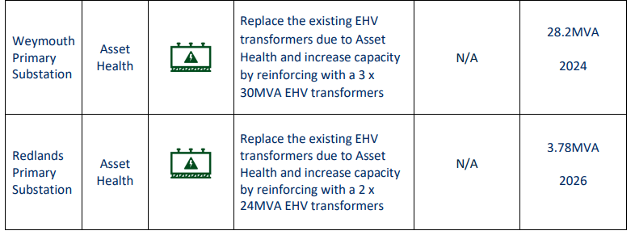
How is demand forecast? Business planning
SSEN’s proposed investments 2023-2028
Axminster
Mannington
Chickrell
14
Notes:
The Plan also notes investment proposals for the next 5 years to 2028, as contained in their latest Business Plan.
This here is SSEN’s.
There’s too much to talk through in detail here, so we’ll circulate the details for you to look at after.
It is worth noting however that they decide on what solution to pursue and when by considering those forecasts, and by doing cost-benefit analysis using standard industry tools.
Importantly, they consider both reinforcements and flexibility measures – and it has a ‘flexibility first’ approach where flexibility measures are used to try and manage capacity efficiently and to delay or avoid reinforcement.
Also note that the proposal are proposals, and what solution they opt for can change at the point where they actually tender works.

Slide 15
How is demand forecast? Business planning
Example impacted projects
 | Technology | Capacity required | Delay
15
Notes:
Now, as we’ve already said, our programmes are already running into some constraints.
From EV chargers to Air Source Heat Pumps, sought installation of some measures is already running into delays up to several years or indefinitely in some cases.
We can talk through this more in the Q&As, but hopefully this makes all the high level analysis a bit more tangible.

Slide 16
Forecasting example:
Electric Vehicles

Slide 17
1.
2.
3.
4.
5.
Scope
Setting the Scene – Future of Electric Vehicles demand
EVCI Background – Story So Far
Dorset – Our Experience
EVCI – Capacity Management Strategies
17

